Slide 1
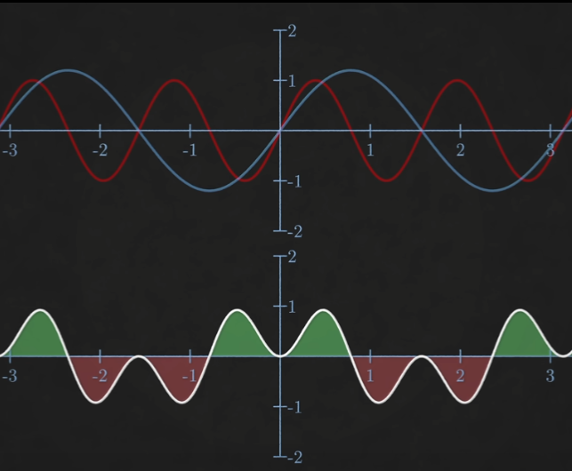
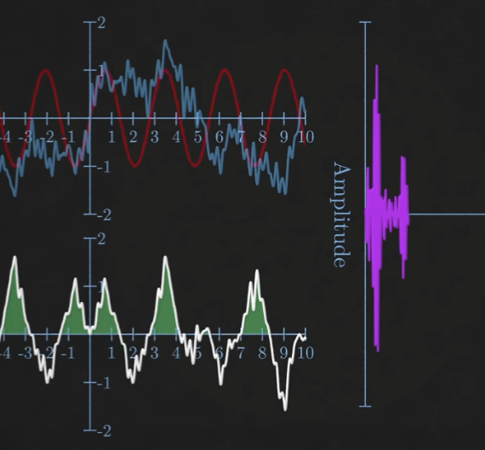
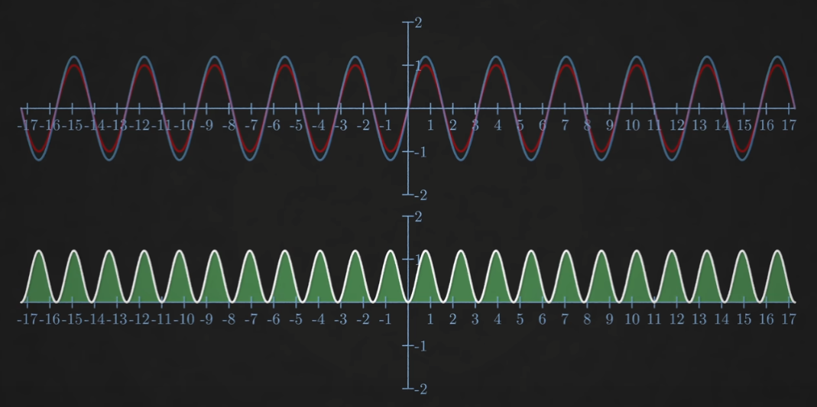
Halfway presentation: Fourier Analysis in Optical Coherence Tomography
Saban Caliskan
Research Internship

Slide 2

Fourier Transform
Lineair Transformation
$\hat{f}\left(ξ\right)=\int_{−∞}^{∞}{f\left(x\right)ⅇ^{−ⅈ2πξx}ⅆx}$
$f_{inv}\left(x\right)=\int_{−∞}^{∞}{\hat{f}\left(ξ\right)}ⅇ^{−ⅈ2πξx}dξ$
Source: https://en.wikipedia.org/wiki/Fourier_Transform

Slide 3
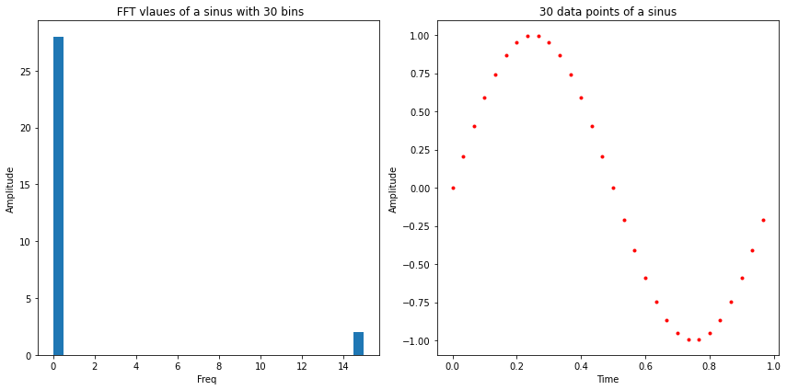
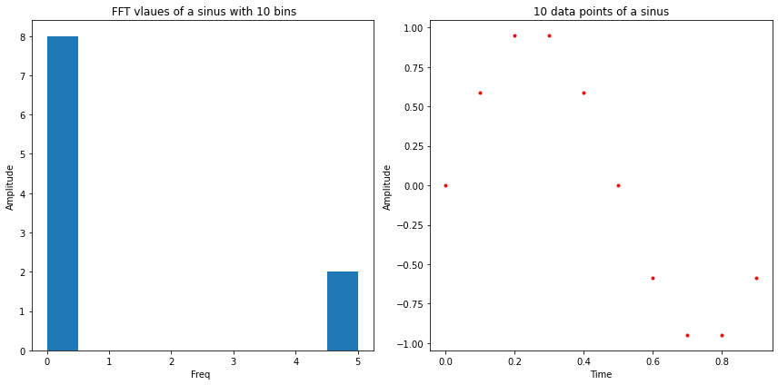

Discrete Fourier Transform
Discrete data
$X_{k}=\sum_{n=0}^{N−1}{x_{n}∙e^{−i\frac{2π}{N}kn}}$
Computation $∝N^2$

Slide 4
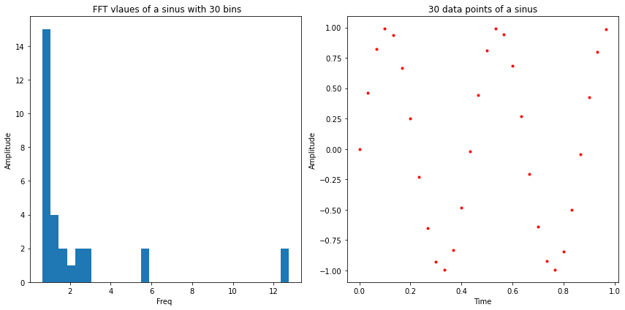
What is our goal?
Finding the most occuring frequency
What if the real frequency is not exactly in the centre of a bin?

Slide 5
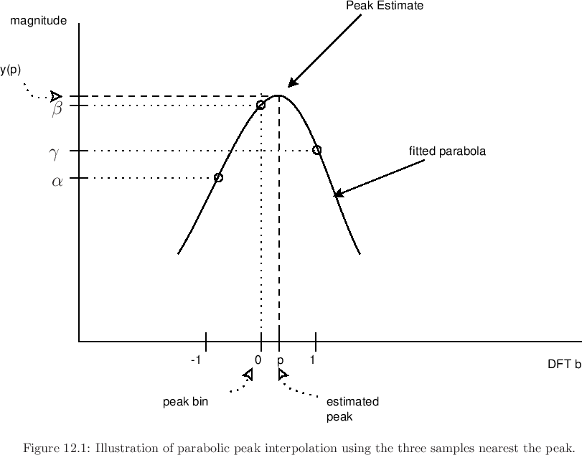
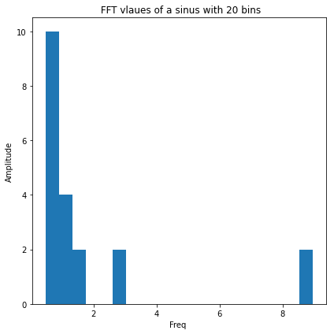
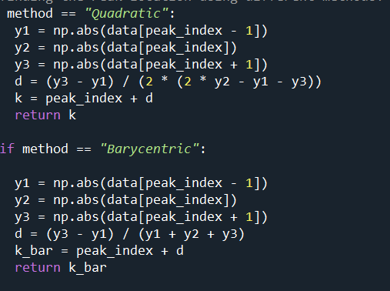
Peak fitting
2 Methods to interpolate the true frequency
Quadratic approach:
2.Barycentric approach:

Slide 6
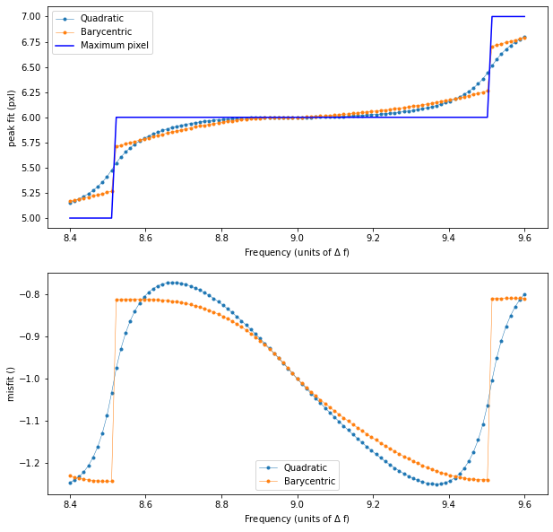
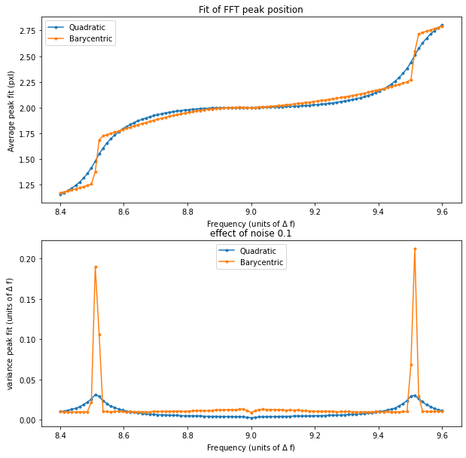
Result of first 2 methods

Slide 7
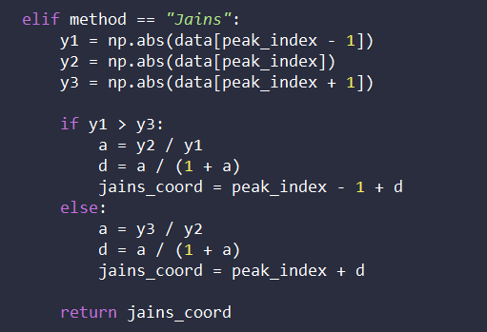
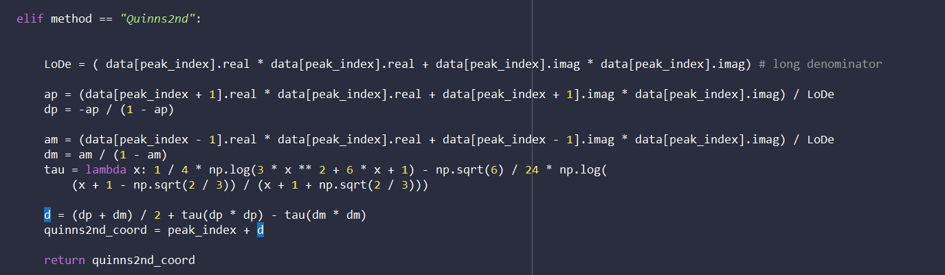
Peak fitting
Other methods we have tried
3. Jain’s method
4. Quinn’s (2nd) method

Slide 8
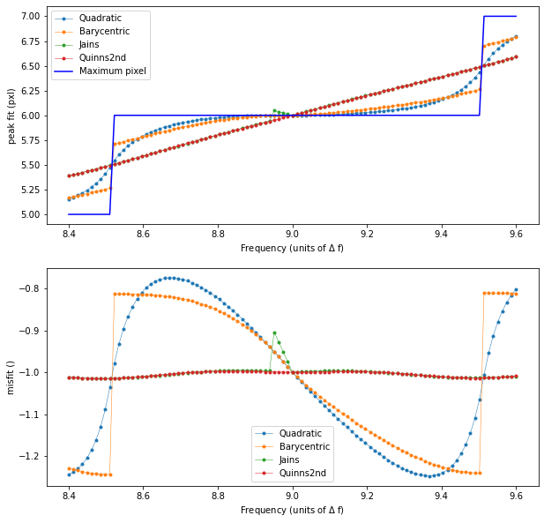
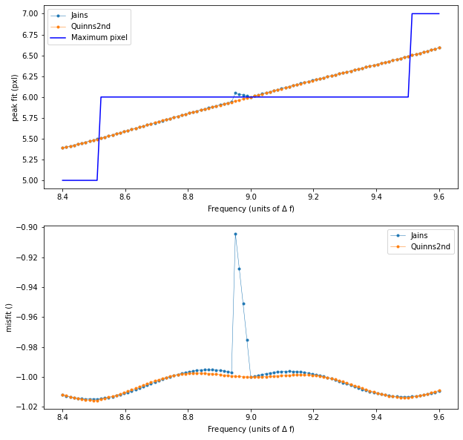
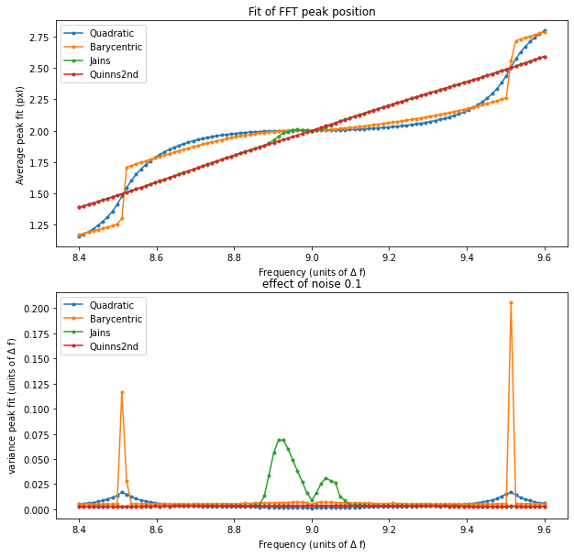
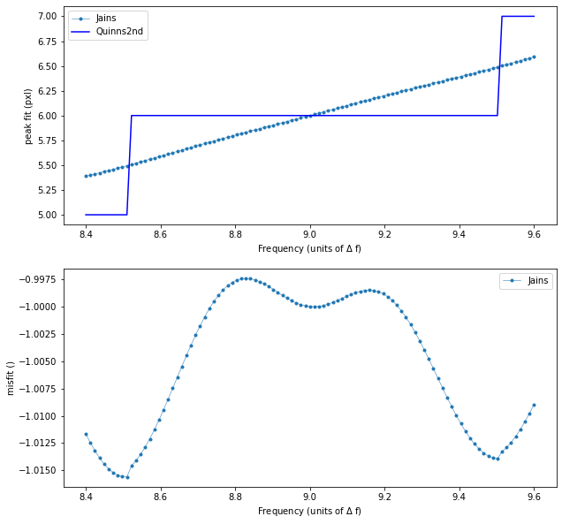
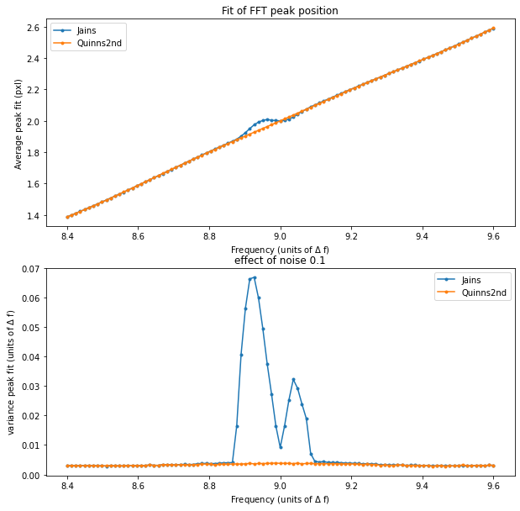
Result Jain’s and Quinn’s
Generally Better
Not Continous

Slide 9
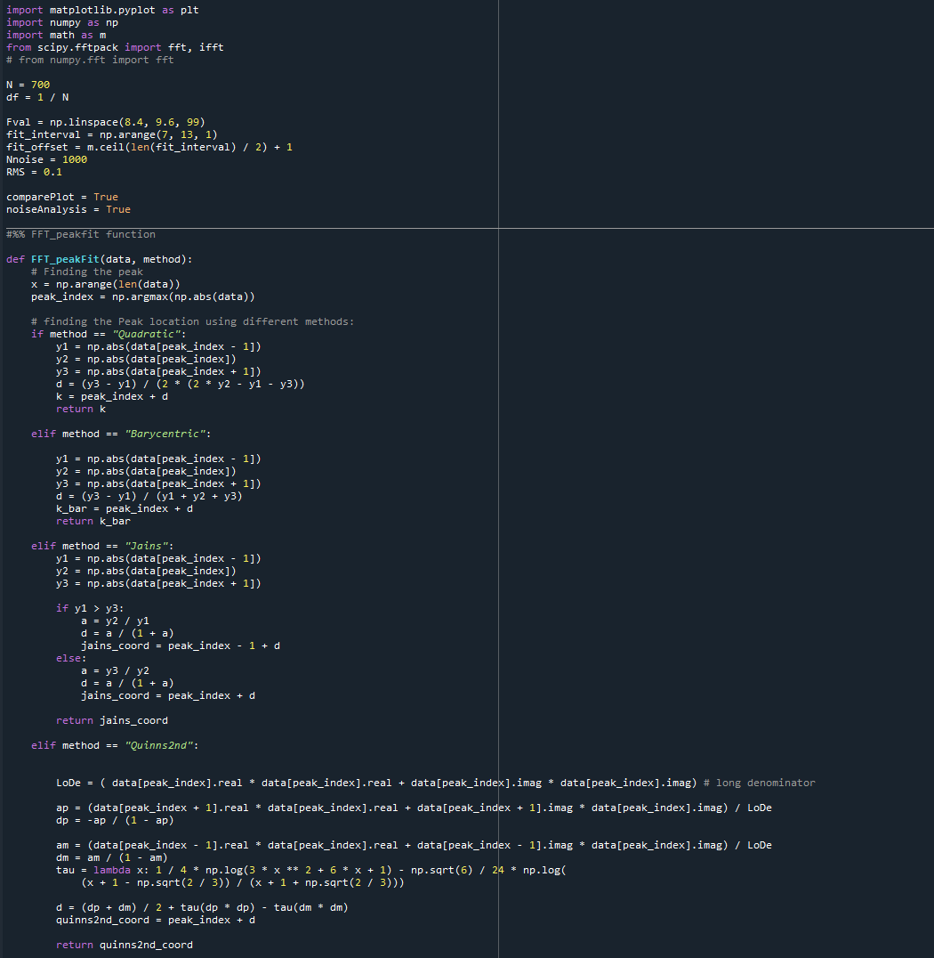
Our code
Currently:
Outlook:

